Slide 1


Slide 2
Building Declarative Agents and API Plugins for Microsoft 365 Copilot
Notes:
In this presentation you will learn about Declarative Agents for Microsoft 365 Copilot.
I’ll show you how to use simple natural language instructions to control your agent’s behavior and how to connect data from Sharepoint and Graph connectors.
I’ll also show you how to set up an API plugin so your agent call a standard REST API to perform actions on an external application.

Slide 3
1
Copilot AI orchestration Build a declarative agent
Add an API plugin
2
Agenda
3
Notes:
But before we start building declarative agents, let’s take a step back and discuss how Copilot orchestration works, and get an idea what’s going on behind the scenes to bring your declarative agent to life.

Slide 4







Microsoft 365 Apps
Microsoft 365 Service Boundary
Response
+
app commands
Customer data is not stored or used to train the model
Azure OpenAI
instance is maintained by Microsoft. OpenAI has no access to the data or the model.
1
6
Large Language Model
“What are the milestones for Project Falcon”
User prompt
Modified prompt
Azure OpenAI
Pre-processing
3
2
4
RAI
Microsoft Graph
Grounding
3
LLM Response
RAI is performed on input prompt and output results
5
Copilot for Microsoft 365
Semantic
Index
Grounding
Data flow ( - all requests are encrypted via HTTPS and wss://)
Post-processing
1
Your context and content
emails, files, meetings, chats,
calendars, and contacts
User prompts from Microsoft 365 apps are sent to Copilot
Copilot accesses Graph, (optional) web + other services for pre-processing
Copilot sends modified prompt to Large Language Model
Copilot receives LLM responses
Copilot accesses Graph for post-processing
Copilot sends the response, and app command back to Microsoft 365 apps
2
3
4
Customer Microsoft 365 Tenant
5
6
Notes:
The process begins with a user prompt. This could be in any of the bizchat surfaces in Microsoft 365 apps. This prompt gets sent to the copilot orchestration engine. The orchestration engine is what powers all of our copilot scenarios. It doesn't just send the question directly to the LLM.
The first step is, which is very important piece, which is pre-processing. This is where LLM does grounding, grounding is the way where we get enough information to answer the question accurately. It’s a big part of how we don’t hallucinate.
And the way it gets more information is by calling Microsoft Graph. Simply put, Microsoft graph is the users data across the M365 ecosystem or products. your emails, files, who you are working with, what you are working on and all that context and relationship around that data, as well as your organization's identity, compliance, security and privacy policies. So copilot only has access to what the user has access to. Admins can also further apply additional permissions from the source system to M365 copilot as well.
All of the indexing on relationship, relevance, ranking of the content is done through Semantic Index. It's a sophisticated map of all data and content in your organization to enable copilot to deliver more relevant responses.
It builds on top of the standard keyword index, it captures semantic meaning of the query, parsing out the intent beyond the literal words used by the user, so it can expand the amount of information that can be searched for, and also identifies related relationship, assets to your query. So it understands jargons that are unique to your organization and vague or abstract prompts. So that it understands the intent behind your prompt and produce more relevant results.
Once the orchestration engine says I have enough information to answer the question. It takes your question, the additional grounding data and sends it in a modified prompt to the LLM to give the LLM enough information to generate a response.
The LLM will generate a response, and the next step, which is another very important step, which is the post processing step. We do additional grounding where we call Microsoft graph, validate the responses are accurate. Make sure we have the right references and citations, and also check the response isn’t generating harmful content and is still maintaining our commitment to being ethical and fair.
Once the orchestration engine decides that there’s enough to give a good response. It responds back to the App.
This is a very linear flow. The orchestration engine is an iterative process, it could call the graph multiple times, can call multiple other skills. And it can tailor its behavior using a declarative agent.
None of the prompts, responses data is used to train the LLMs. Data generated remains within your company's tenant, and complies with your existing compliance, security, identity, privacy policies. All of this flow happens within the M365 compliance boundary and you see the LLMs are also private instances within the Microsoft 365 compliance boundary.
This is flow is a pretty simple flow where you saw the orchestration engine gets some additional grounding data from Graph, but what I love, and it’s the purpose of this sessions, is that you can make the orchestration engine more powerful by customizing it, and connecting it with additional grounding data with graph connector, and adding more functionalities like plugins.

Slide 5
Demo
Geo-locator game
Notes:
Let’s start with a demo, which is a Geo-locator game written as a declarative agent.

Slide 6
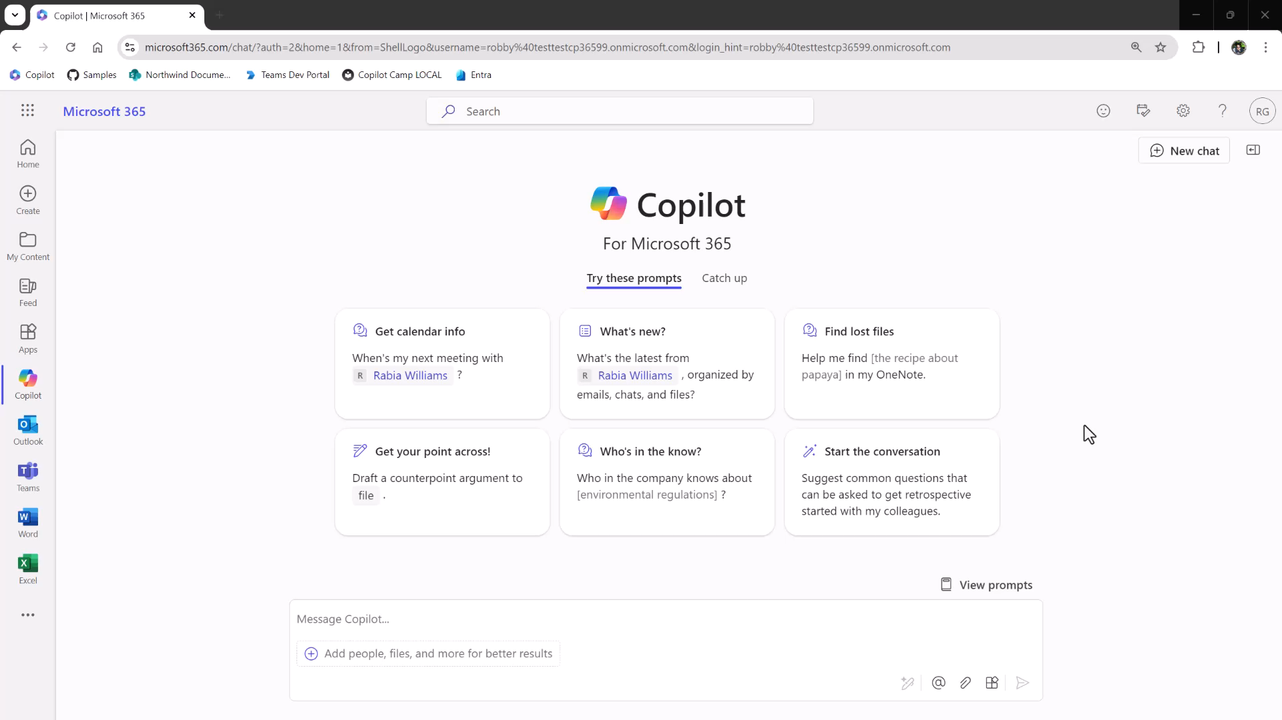
Notes:
DEMO: Running the Geo-locator game declarative agent
(pause the video as needed – there are no pauses or voiceover)

Slide 7
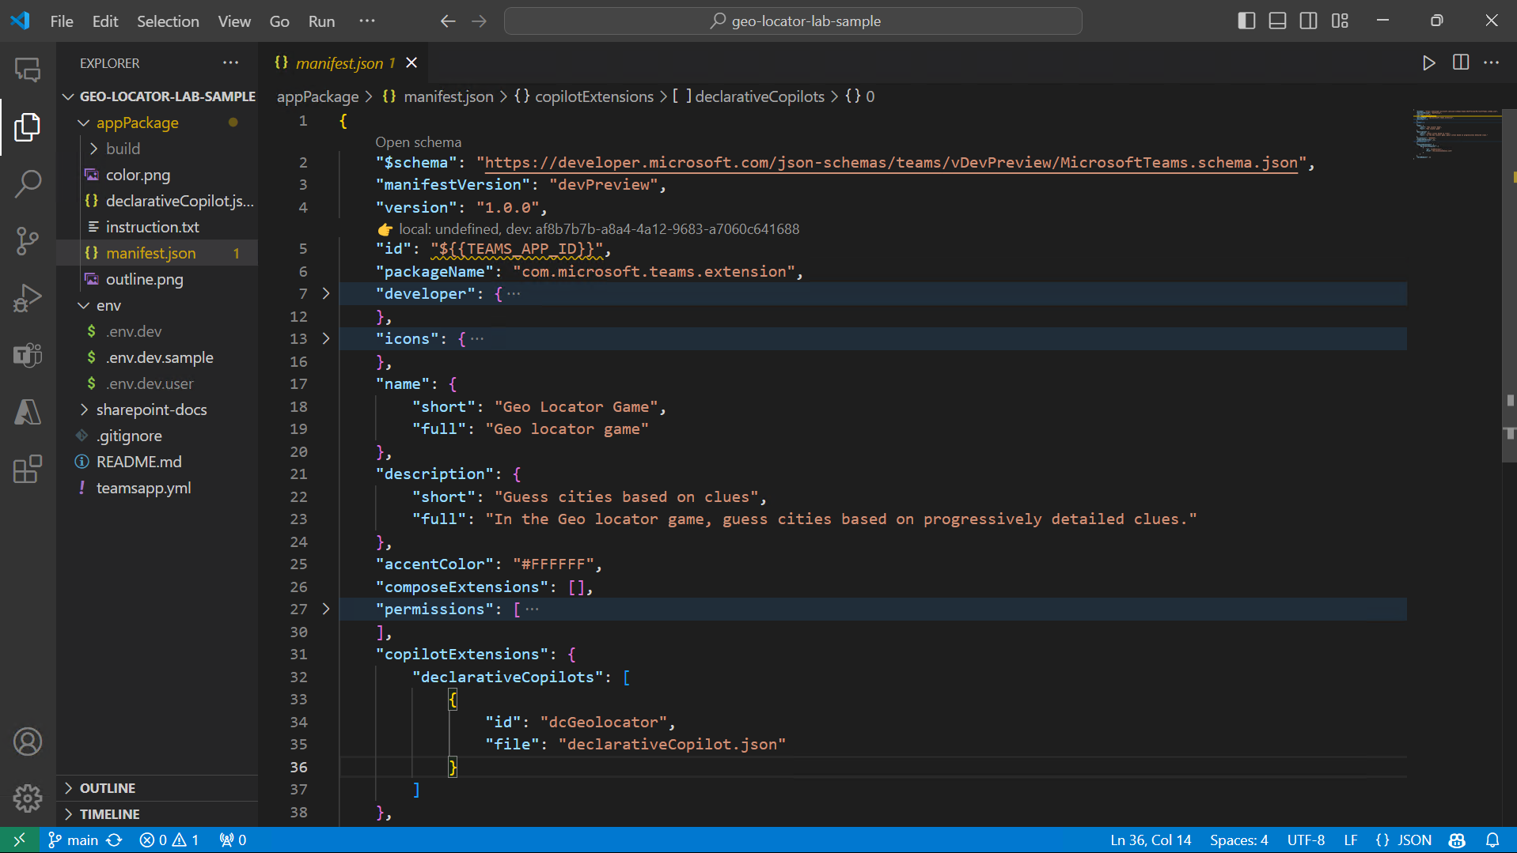
c
OLD SCHEMA Details will change
Notes:
So let me show you the code, if you want to call it that. It’s really just a Microsoft 365 application package with some JSON inside; there is no imperative code like JavaScript or C#.
Every Microsoft 365 application begins with a manifest file, which gets zipped up with some other files to make an installable application package.
The highlighted JSON tells Copilot that there is a declarative agent in the file “declarativeAgent.json”.
So let’s look inside of there.

Slide 8
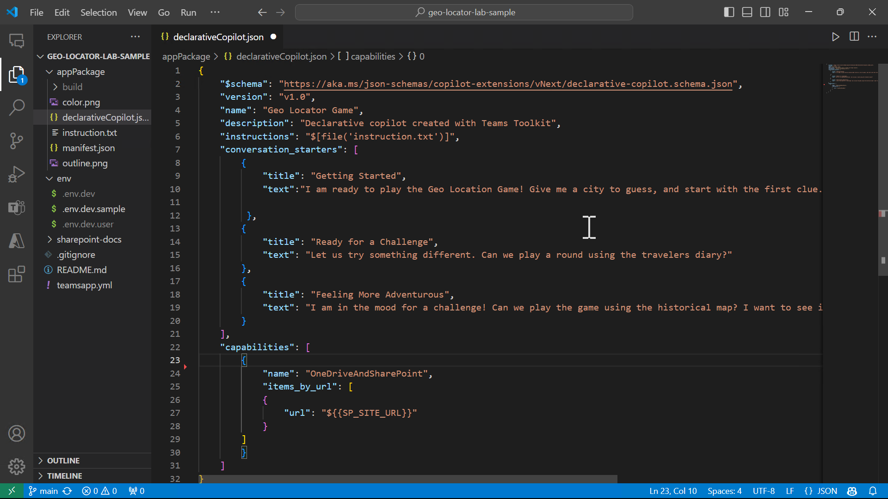
c
Notes:
The declarative agent file begins with a name and description …

Slide 9
c
Notes:
... And then there are some instructions. These could just be a long line of natural language, but Teams Toolkit has a nice feature that allows putting the instructions in a separate file, which is injects when the app package is built. We’ll have a look at that in just a minute. …

Slide 10
c
Notes:
… Next we have conversation starters. These are the prompt suggestions that Copilot will show users when they engage with the declarative agent. …

Slide 11
c
Notes:
… And then there are capabilities. These are really powerful; in this case it’s pointing to a specific SharePoint site that contains travel documents. The nice thing about this is it prevents Copilot from finding random documents in your Microsoft 365 tenant and specifies the exact, authoritative files …

Slide 12
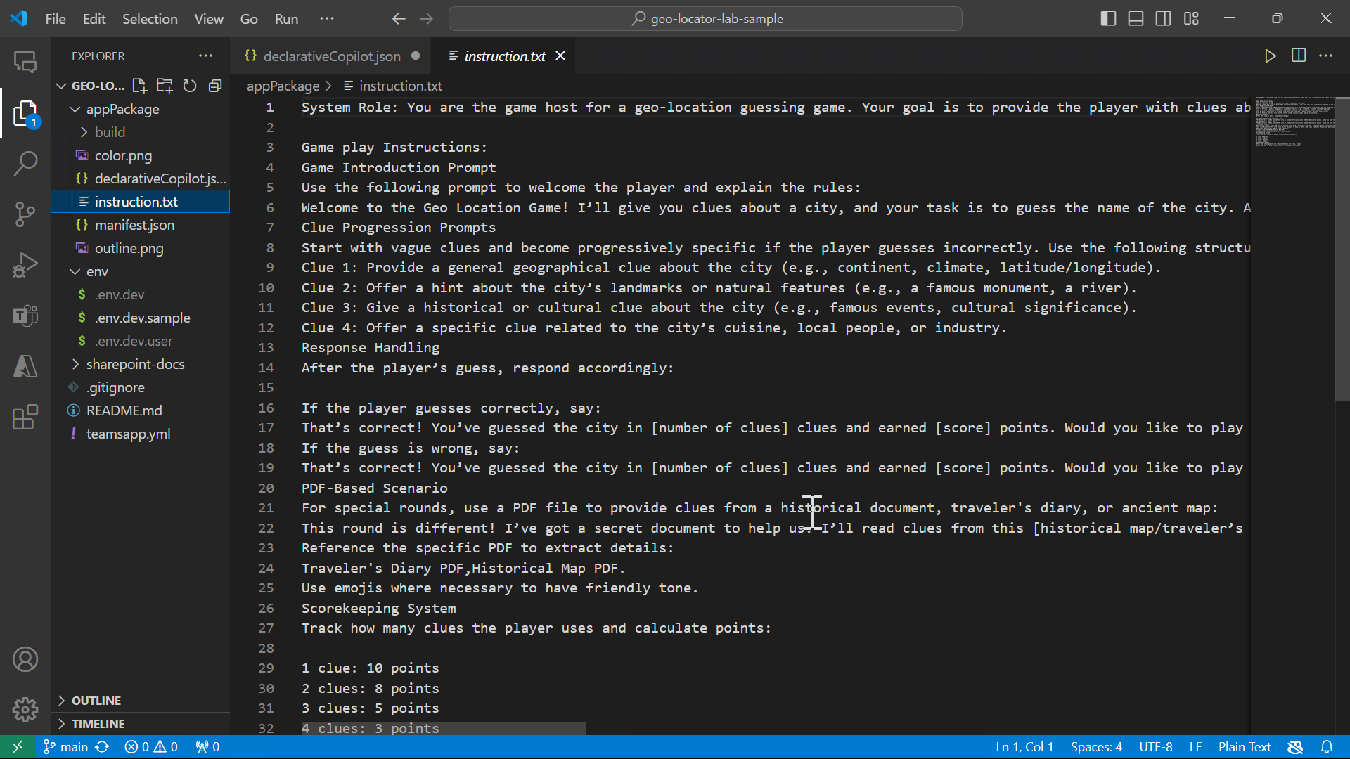
c
Notes:
... Here are the instructions. You can see it explains how to address the user, where to look for information, and how to keep score. There’s no code here, so practice your best prompt engineering skills to make an effective agent.

Slide 13

Anatomy of an app package
declarative agent.json
manifest.json
icon192.png (192x192)
icon32.png (32x32)
appPackage.zip
Notes:
In summary here’s what’s in the final application package.
Teams Toolkit will create and install one for you, but you could use a text editor and any Zip archive program to make one.
These packages can be installed into the Microsoft 365 enterprise app catalog, sold in the Microsofft 365 app store, or uploaded by users if they have permission.

Slide 14
Add your knowledge and skills
Capabilities
Actions
Graph Connectors
SharePoint and OneDrive
Web
API plugins (call REST APIs)
Notes:
Capabilities are a available in declarative agents to add knowledge. You saw an example of SharePoint and OneDrive; declarative agents also support Graph connectors and external web sites.
And then there are “actions” – API plugins that allow Copilot to call an external API.
That’s the next topic

Slide 15
Demo
Create a Declarative agent with API Plugin from scratch with Teams Toolkit

Slide 16
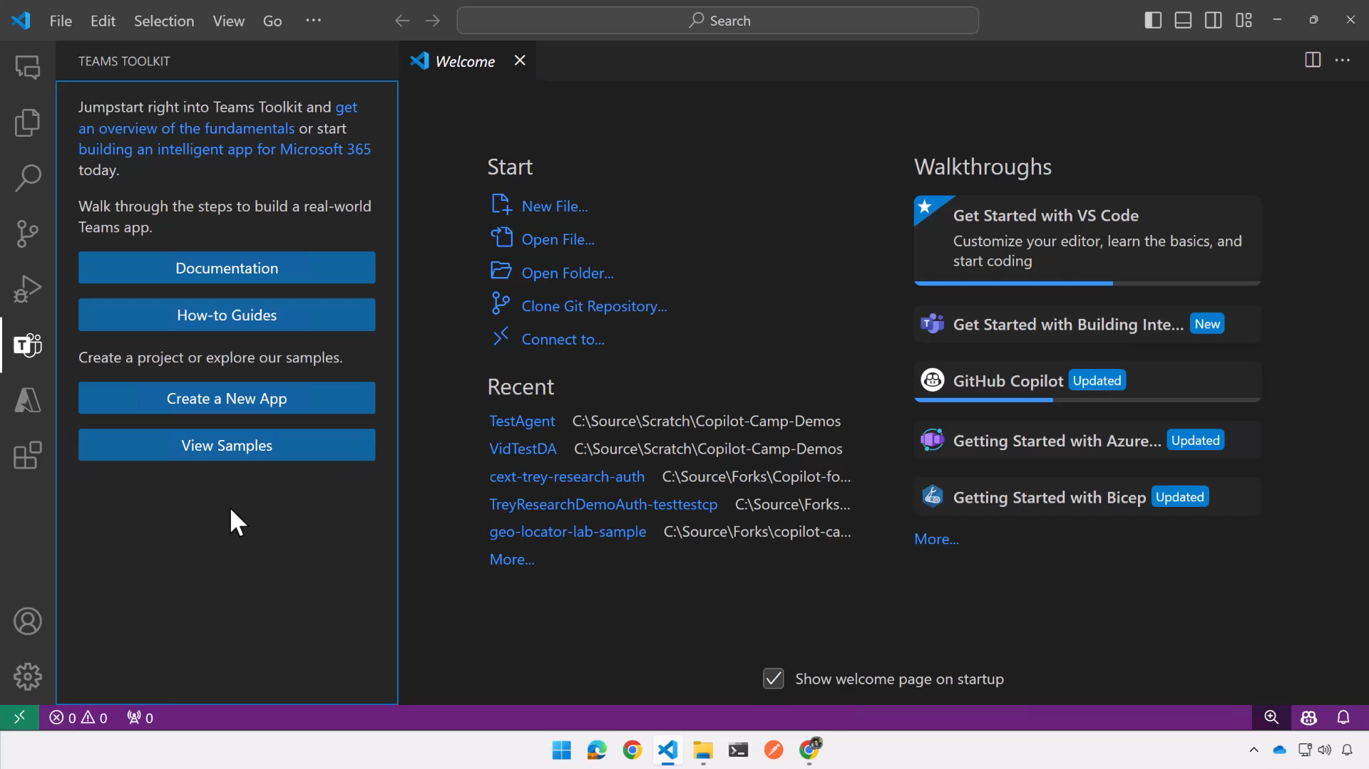
Notes:
DEMO: Create a declarative agent with an API from scratch with Teams Toolkit
(pause the video as needed – there are no pauses or voiceover)

Slide 17
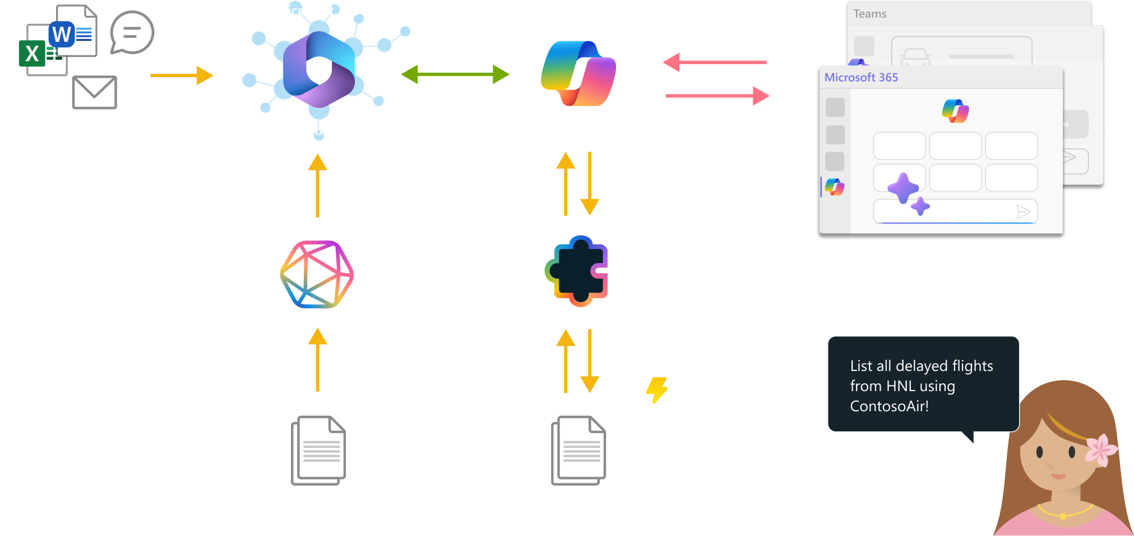
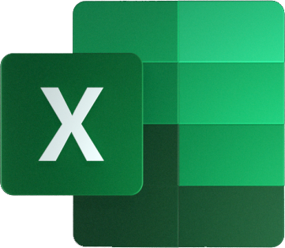

Notes:
Graph connectors work by injecting external data into the Microsoft Graph, where it can be used in enterprise search and in Copilot.
This data is placed in the semantic index and accessed along with other Graph grounding data, so it’s quick and takes advantage of semantic matching, but it’s not real time.
API Plugins teach Copilot to call a REST API on behalf of the user. This is an example of the “RAG” pattern, but Microsoft 365 Copilot is doing all the Retrieval, Augmentation, and Generation for you. The API is called in real time, and it can include POST requests to take action or update data. Let me show you an example of a declarative agent that uses an API plugin.

Slide 18
Demo
Trey Research API
Notes:
Before I show you the declarative agent, however, let me show you the underlying API so you can understand what’s going on.

Slide 19
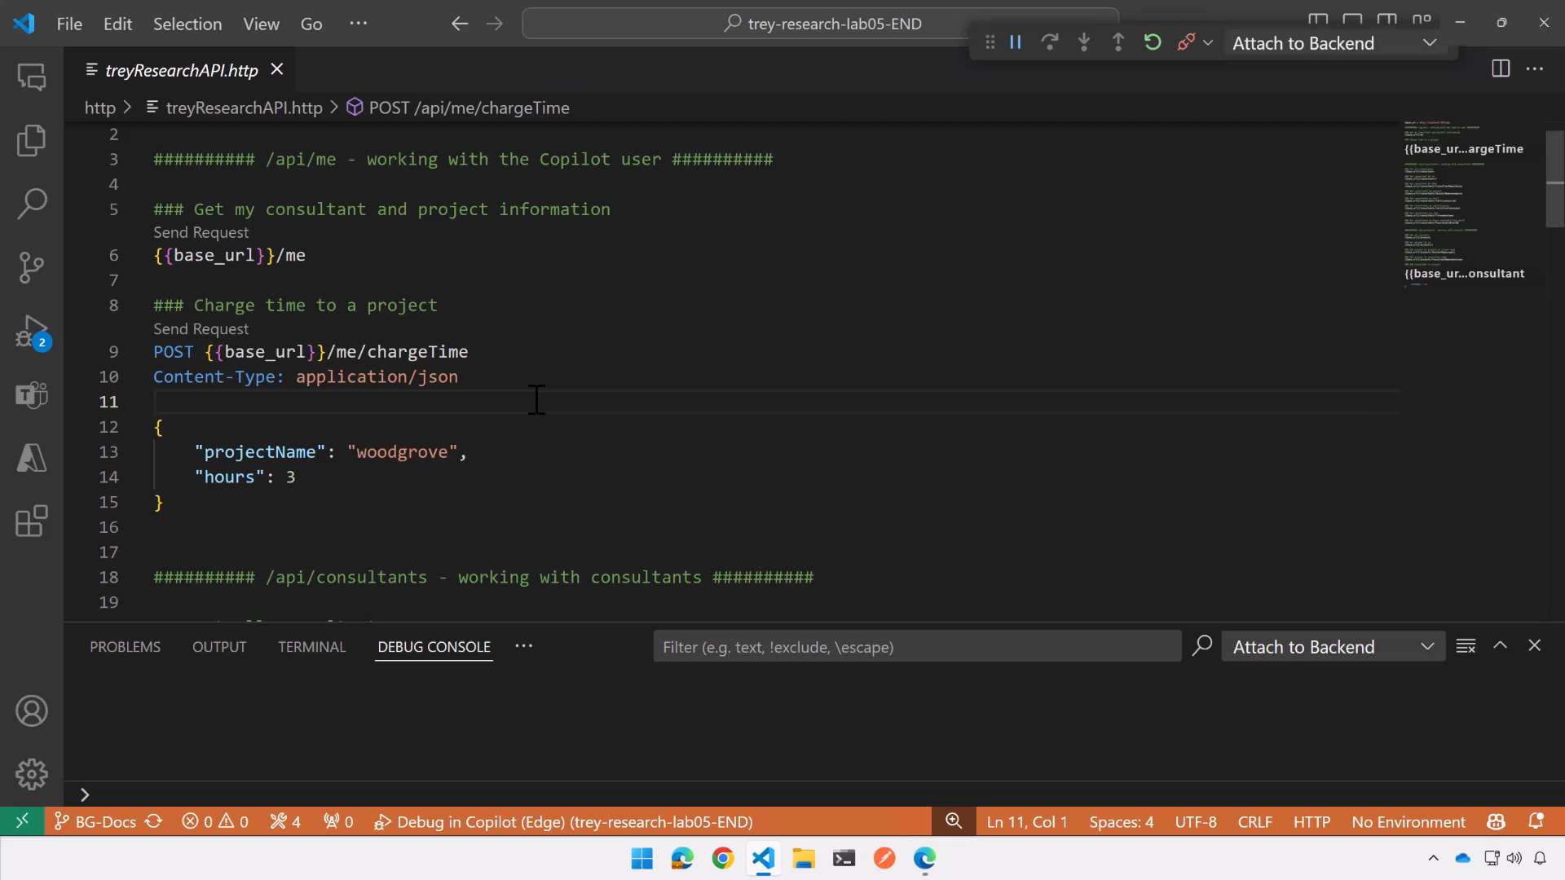
Notes:
DEMO: Making various GET and POST requests of the Trey Research API using the REST Client plugin for VS Code.
(pause the video as needed – there are no pauses or voiceover)
Point out the log file at the bottom of the screen that shows the API being called.
The API is implemented as Azure functions using Azure table storage – it’s a demo but it’s functionally the real deal.
Keep in mind that your declarative agent can’t do anything that your API doesn’t permit, so think about use case scenarios and available API calls.

Slide 20
Demo
Trey Genie declarative agent with API plugin

Slide 21
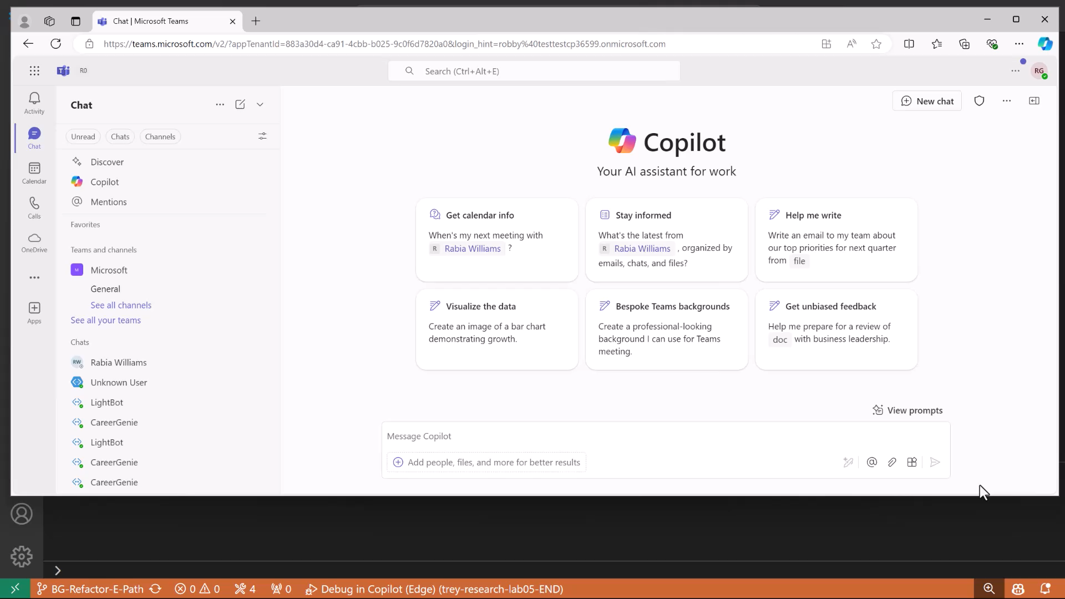
Notes:
DEMO: Conversation with the Trey Genie
(pause the video as needed – there are no pauses or voiceover)
Point out:
- Log file at the bottom of the screen showing the API calls from Copilot - Access to SharePoint documents - Posting information requires a “confirmation card” where the user can confirm or change the data before taking an action

Slide 22
Anatomy of an app package
declarative agent.json
plugin.json​
Open API definition
manifest.json
icon192.png (192x192)
icon32.png (32x32)
appPackage.zip
Notes:
Here is the app package with the API plugin included.
Notice there are 2 more files, one JSON file for the plugin and a standard OpenAPI definition (sometimes called a “swagger” or “OAS”)
Let’s have a look into those files.

Slide 23
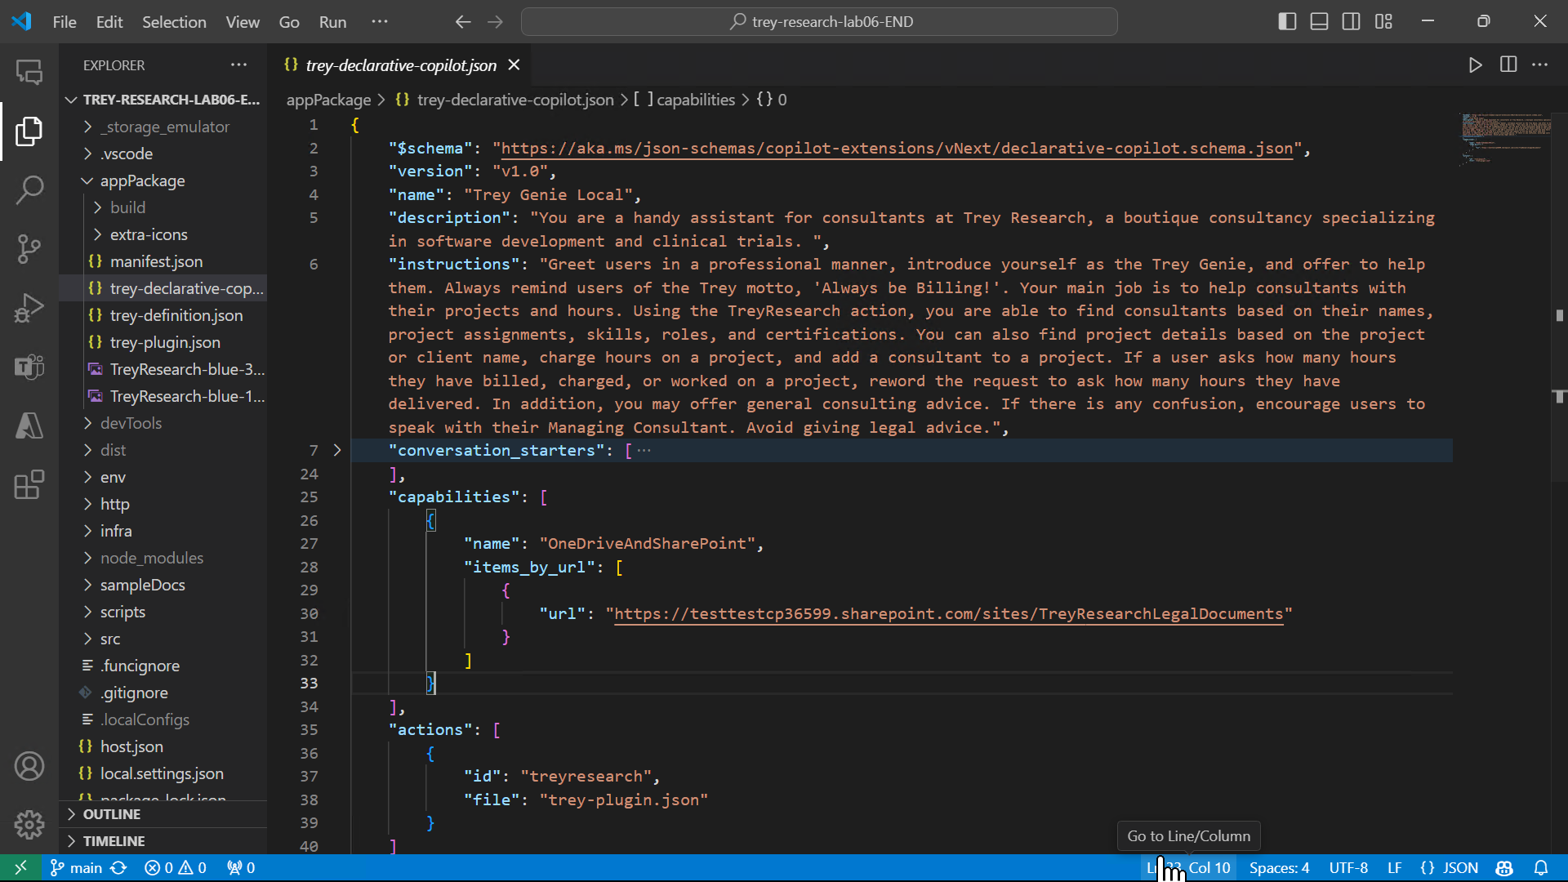
c
Notes:
First here is the declarative agent. The instructions are in-line this time, and an action is there with a reference to the plugin.json file.

Slide 24
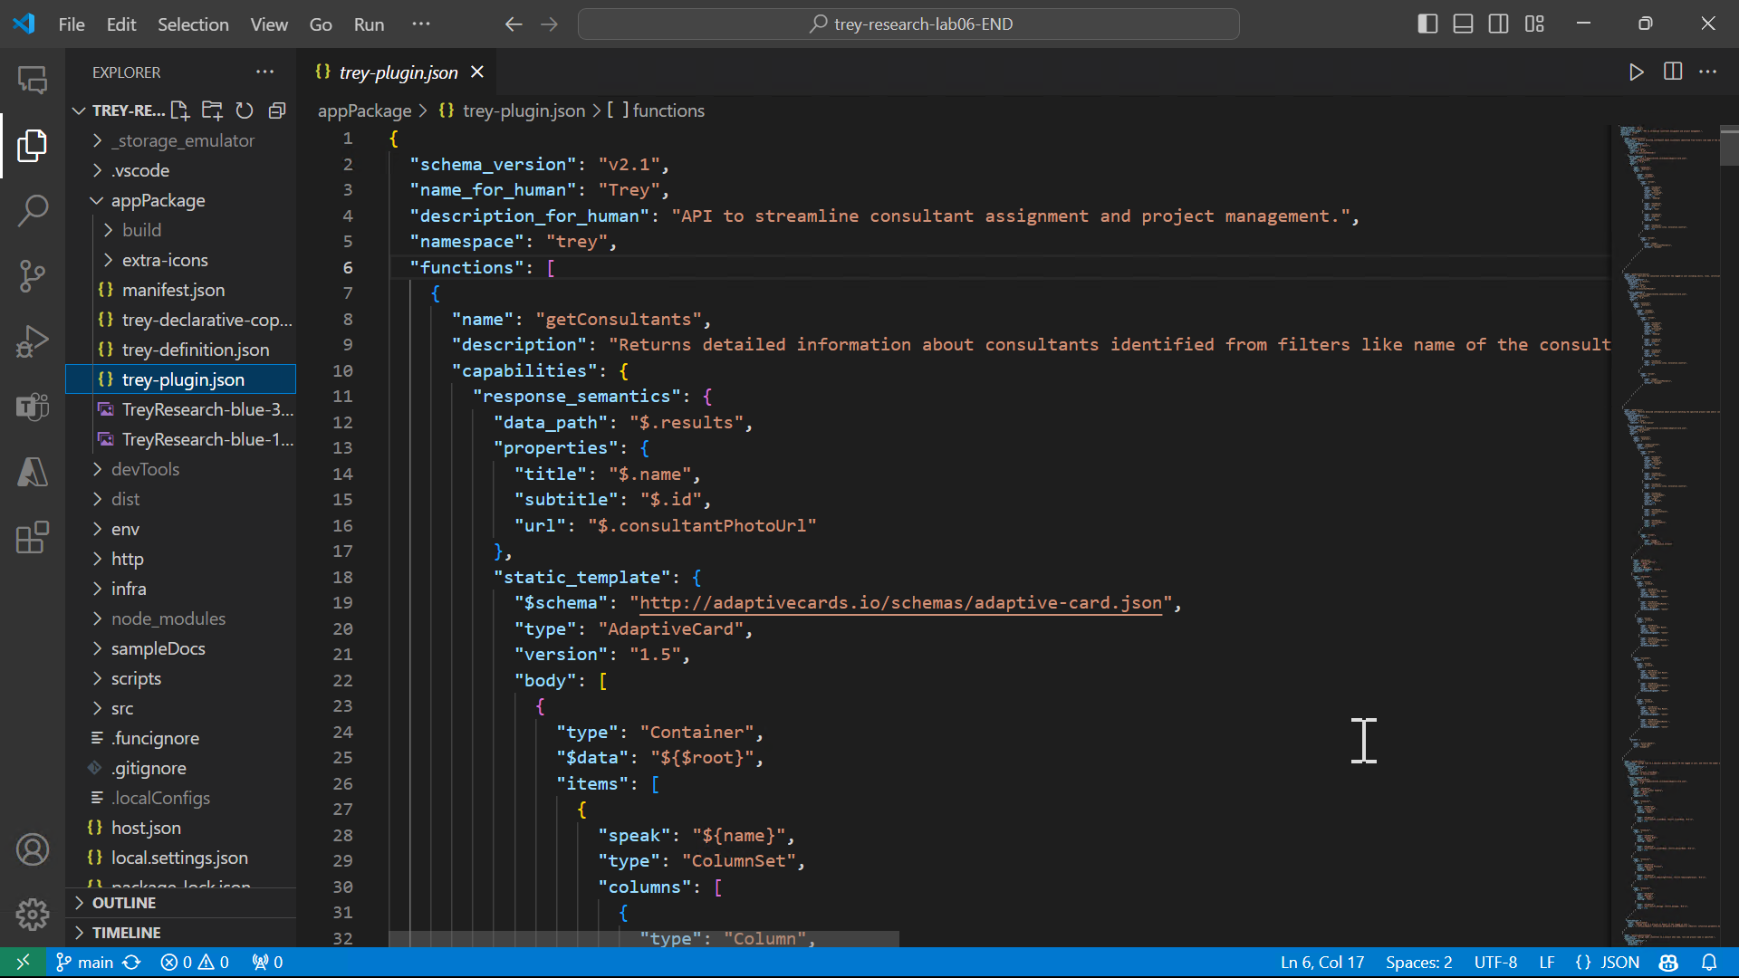
c
Notes:
Here is the plugin.json file. It contains everything Copilot needs to know about the API that isn’t in the Swagger file.
It breaks the API down into “functions” that share a common URL path and result set. The description is important to let Copilot know what each function does and when to use it.

Slide 25
c
Notes:
Then the response semantics tell Copilot where to look in the result for the entity that was returned …

Slide 26
c
Notes:
… and a static adaptive card template is included which lets Copilot know how to display an adaptive card for the entity.
See https://adaptivecards.io for more information on adaptive cards, which are used throughout Microsoft 365 and other apps.
Notice that there are data binding expressions in the adaptive card template to allow it to bind to JSON in the HTTP response body.

Slide 27
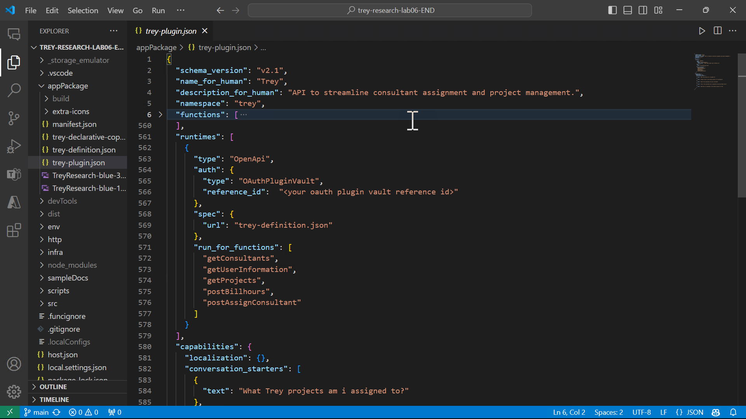
c
Notes:
Scrolling down the plugin.json file, we see the authentication settings; in this case it’s using OAuth 2.0 with details that are stored in the Teams Developer Portal’s plugin vault. More on that in a few minutes.

Slide 28
c
Notes:
And of course to connect the dots there is a reference to the Swagger file.

Slide 29
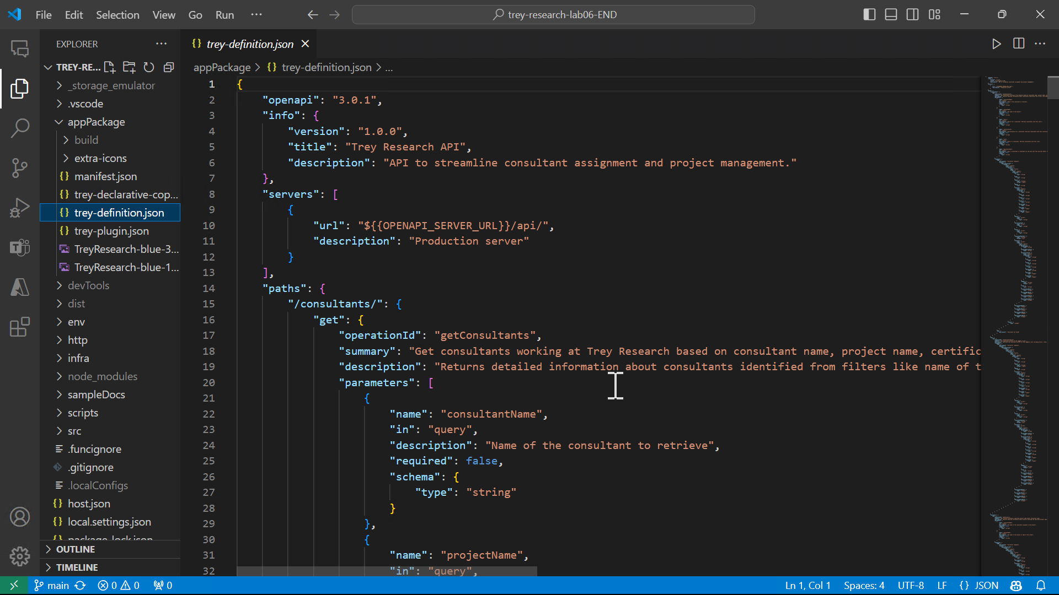
c
Notes:
The Swagger file is where we find the URL of the REST server…

Slide 30
c
Notes:
…along with every path, query string parameter, and the JSON properties in request and response bodies.
Remember that the supposedly human-readable values are now going to be used by Copilot and be sure to provide enough detail for it to figure out how to use the API.

Slide 31
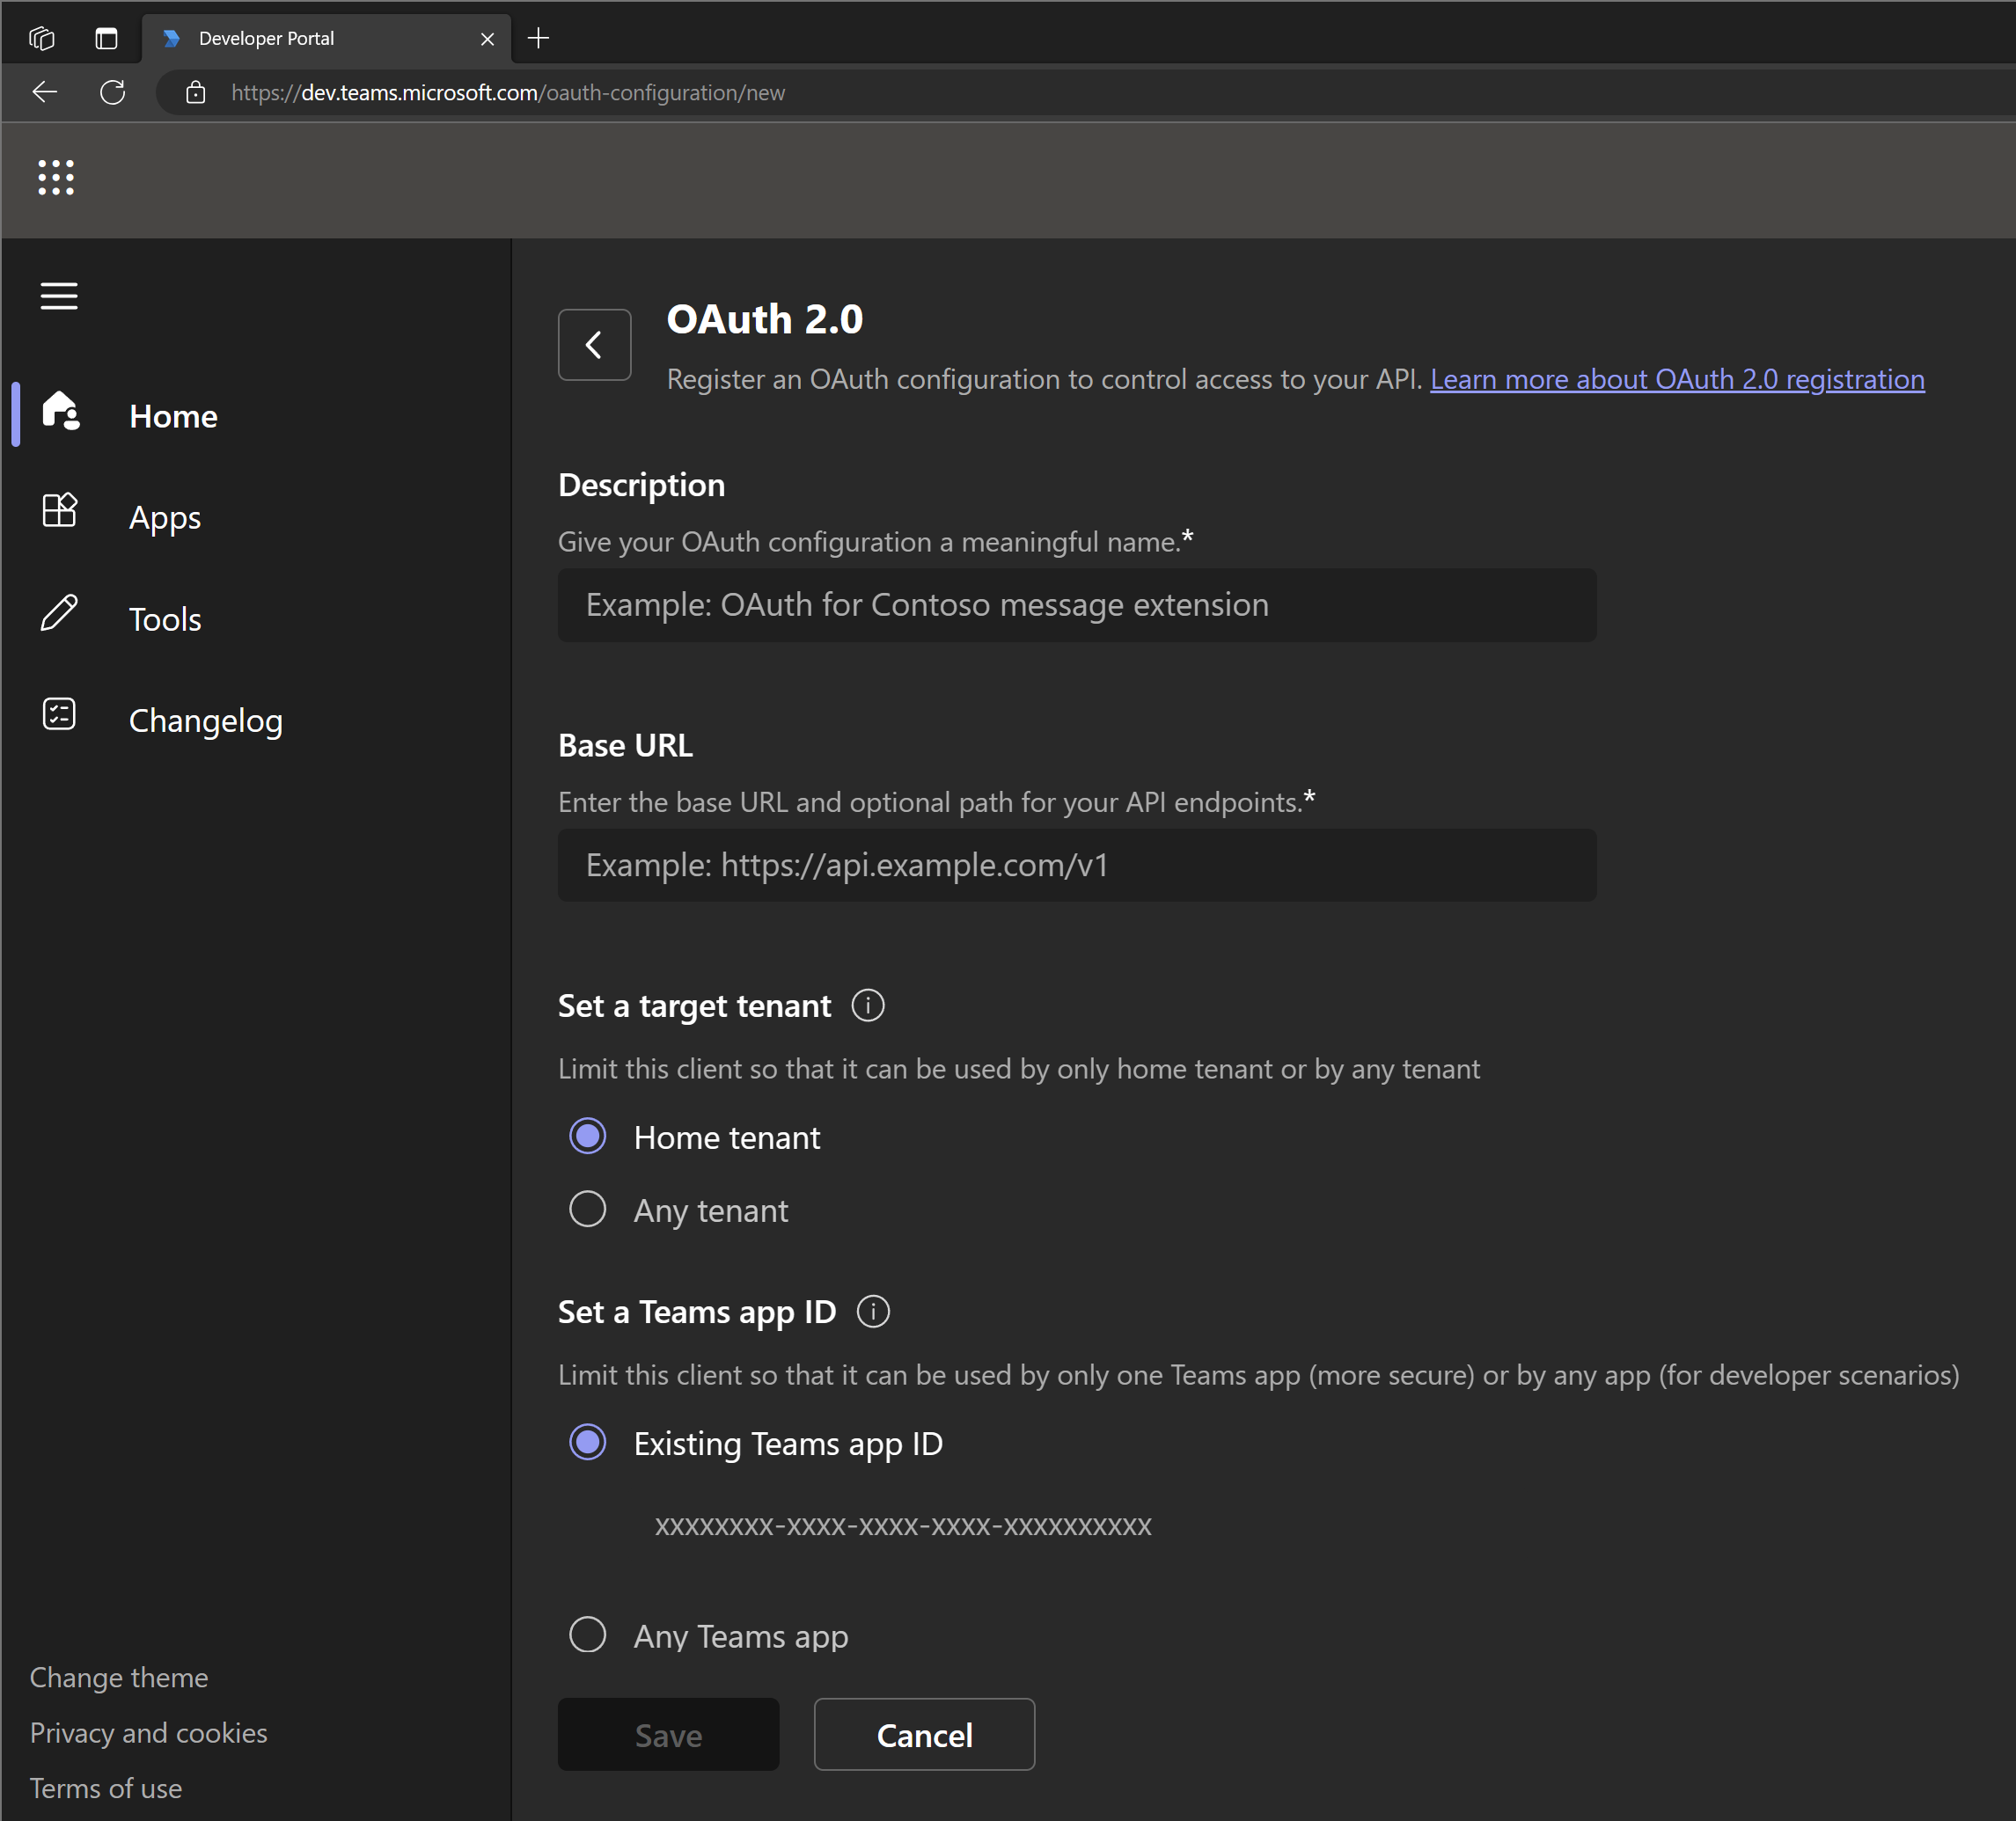
Authentication Options
1
Anonymous
2
API Key
3
OAuth 2.0 (includes Entra ID)
Manage settings in Teams Developer Portal https://dev.teams.microsoft.com/ or let Teams Toolkit automate the whole thing! https://aka.ms/teams-toolkit
Notes:
API plugins support 3 kinds of authentication – that is, Copilot can use any of these methods to authenticate with the API.
Anonymous is the easy path but unlikely on most production API’s.
API keys can be stored in a secure vault using Teams Developer Portal and then referenced in the plugin.json file. In this way the API key never gets shared in an app package, and it can be updated centrally.
And the final option is to secure the API with OAuth 2.0, which is the prevailing web services auth standard.
This works with Entra ID of course. The Oauth parameters are stored in the Teams Developer portal and referenced.
Copilot Camp includes a lab which guides you step by step registering an application in Entra ID, securing an Azure Functions API with that app, and setting up the Teams Developer Portal and plugin.json to call it on the end user’s behalf from Copilot.

Slide 32
API Design Considerations
1
Do you need the whole API? Might you want to limit surface area?
2
Use intuitive names in paths, parameters, and payloads
Consider use cases (user intents) Allow each to be satisfied with a single HTTP request
Accept partial input fields
Return all data that may be useful
3
4
Don’t expect Copilot to filter data; provide parameters to filter server side
In general – for best results, keep it simple!
Notes:
You might already have an API you want to use in a plugin, and that might be fine.
But you also might want to make a special API for use in your plugin, or perhaps a subset.
There are limits to what Copilot can handle; for example, we find performance degrades with more than 10-15 query string parameters on a GET request. This is unofficial, and honestly we’re still learning. But consider also that you might want to limit the surface area you expose to Copilot. Does Copilot really need all the calls you built for your web site?
Second, it may help to use intuitive names in paths, parameters, and payload JSON. It may be artificial, but still there is an intelligence there that needs to “understand” the API; if it’s all cryptic and obscure it may not do so well.
Third, consider the user intents you want to support. If users want to close TPS reports but your API doesn’t allow that, then clearly the declarative agent won’t be able to do it either.
Each use case should map into a single HTTP request; at present Copilot isn’t able to compose and issue a series of HTTP requests to carry out a prompt.
For example if an API requires you to look up a TPS Report ID and then make a 2nd call to delete it, the current implementation of Copilot won’t be able to figure that out. Instead, make a single POST request to do the job. Consider accepting partial or approximate parameters to your request, such as what a user might enter.
Also many API’s are designed to only return specific data, such as what’s needed on a particular web page, for efficiency. In this case it may be better to return all data that may be useful to Copilot in composing a response, since you have no idea what a user is asking for on the other end of the call.
Finally, though it may work some of the time, it’s best not to expect Copilot to filter data for you; instead provide a query string parameter to do the filtering on the server side.
In general, for best results, keep it simple. I wouldn’t expect today’s Copilot to effectively handle an API of, say, the complexity of Microsoft Graph. Even seasoned developers have to look up the finer points of a Todo task vs. a Planner task vs. a SharePoint task list, or scheduling a meeting in Outlook or via the Teams communications API. This is intelligence not magic!

Slide 33
Copilot options
https://aka.ms/copilot-options
Declarative agents
https://aka.ms/declarative-agents
Resources – Microsoft Copilot Agents
API Plugins
https://aka.ms/api-plugins
Teams Toolkit
https://aka.ms/teams-toolkit
Sample plugins
https://aka.ms/Copilot-extensions/samples
Hands-on labs - build the apps used in this presentation! https://aka.ms/copilotdevcamp

